Slide 1



Shark Tank Analysis
Unleashing The Power Of Data In The Tank

Slide 2
Table of contents
Introduction
Objective
Process
Sharks Information
Feature Description
Data Cleaning & Processing
Overview
Shark Analysis
Industry Analysis
Pitchers Analysis
Guest & Start Up Analysis
Uncover Insights
Tools & Technologies & Data Source
Risk & Challenges
Conclusion
Vote of Thanks

Slide 3


Introduction
"Shark Tank US" is a popular American reality television show where aspiring entrepreneurs pitch their business ideas to a panel of wealthy investors. known as "sharks" in hopes of securing funding for their ventures. The show offers a platform for innovators to seek capital and mentorship, showing a diverse range of products and business concepts. It has become a source of inspiration for aspiring entrepreneurs and captivated viewers with its high-stakes negotiations and entrepreneurial success stories.

Slide 4

Objective
My project aims to leverage the capabilities of Power BI to create an insightful and interactive analytics platform for Shark Tank US data. The project aims to provide a comprehensive view of the show’s history , trends and the success stories of business that have pitched their ideas in the tank. By harnessing the power of data visualization , we aim to uncover patterns , identify successful strategies and provide a valuable tool for investors , entrepreneurs and fans alike.

Slide 5

Process
1
Data Understanding
2
Data Cleaning
3
Data Modelling
4
Data Analysis
5
Uncover Insights

Slide 6

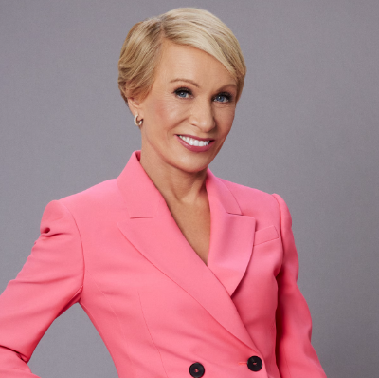
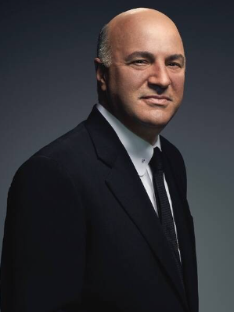
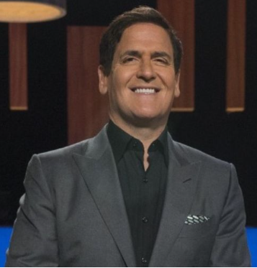


Sharks Information
Daymond John
(CEO and Founder of FUBU(contemporary sportwear))
Kevin O’Leary
(Co-founded Softkey Software Products)
Barbara Corcoran
(The residential real estate company The Corcoran Group)
Lori Greiner
(Co-founder of The Sleep Styler)
Robert Herjavec
(Founder of BRAK Systems)
Mark Cuban
(He owns NBA’s Dallas Mavericks & is cofounder of cost plus drugs)

Slide 7
Feature Description
Shark Tank dataset of USA/American business reality television series . Currently, the data set has information from Shark Tank season 1 to Shark Tank US season 15. The dataset has 52 fields/columns and 1200+ records.
Below are the features/fields in the dataset:
Season Number – (1-15)
Startup Name – Startup Company Name
Episode No. – Ep. No. within the season
Pitch No. – Overall Pitch No.
Season Start – Season 1st aired date
Season End – Season last aired date
Industry – Industry name or type
Business Description
Pitchers Gender
Pitchers City – US city of Pitchers
Pitchers State – US State/Country of pitchers, two letter shortcut
pitchers Average Age
Entrepreneur Names – Pitcher Name
Multiple Entrepreneur – 1-Yes , 0-No
US Viewership – Viewership in US , TRP rating , in millions
Original Ask Amount – in USD
Original Offered Equity – in %
Valuation Requested – in USD
Got Deal – 1-Yes , 0- No
Total Deal Amount – in USD, including debt/loan amount
Total Deal Equity – in %
Deal Valuation – in USD
No of sharks in deal
Investment Amount Per Shark
Equity per shark – Equity received by each shark
Royalty Deal – Is it royalty deal or deal with advisory sales
Loan – Loan/Debt amount given by shark , in USD
Barbara Corcoran Investment Amount
Barbara Corcoran Investment Equity – received by Barbara
Mark Cuban Investment Amount
Mark Cuban Investment Equity
Lori Greiner Investment Amount
Lori Greiner Investment Equity
Robert Herjavec Investment Amount
Robert Herjavec Investment Equity
Daymond John & Kevin O’Leary Investment Amount
Daymond John & Kevin O’Leary Investment Equity
Guest Investment Amount
Guest Investment Equity
Each Shark Present – Whether they present in episode or not

Slide 8
Data Cleaning & Processing
Handling Null values
Removing Duplicates
Delete irrelevant features
Checking Data Types
Adds some new features
Making new Tables according to my needs
Make relationships between various tables in Power BI
Collecting extra information from other sources which I’ve missing in my data
Background Design in Power Point
Generates KPI’s
Importing Images
Dashboard Building
Make buttons for page navigation
Uncover insights

Slide 9


01
Overview

Slide 10
KPI’s
Total No of Seasons
15
No of Sharks
6
No of Pitches
1290
No of Successful Deals
775
Avg Valuation requested by Entrepreneurs
3.54 M
% of pitches that result in a deal
60.08%
Count of Industry
16
Total Deal Amount
229M
shark Equity Count
19K
Average Viewership
5.12

Slide 11

02
Shark Analysis

Slide 12

01
02
03
Mark Cuban
Total Investment:- 60M
Lori Greiner
Total Investment:- 44M
Robert Herjavec
Total Investment:- 36M
04
05
06
Kevin O’Leary
Total Investment:- 28M
Daymond John
Total Investment:-
20M
Barbara
Total Investment:- 18M

Slide 13

03
Industry Analysis

Slide 14

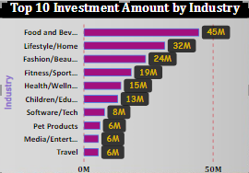

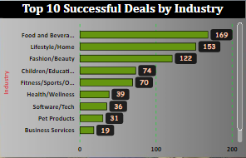


Slide 15
04
Pitchers Analysis

Slide 16
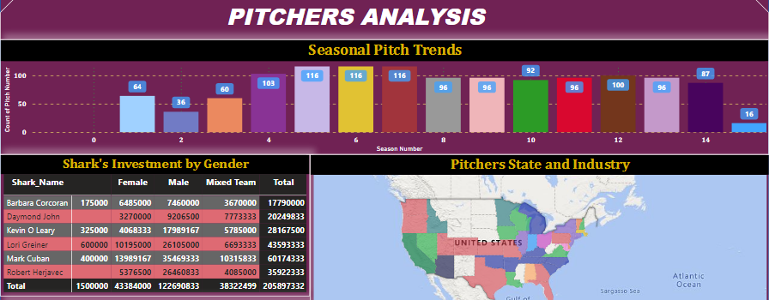

Slide 17
05
Guest & StartUp Analysis

Slide 18
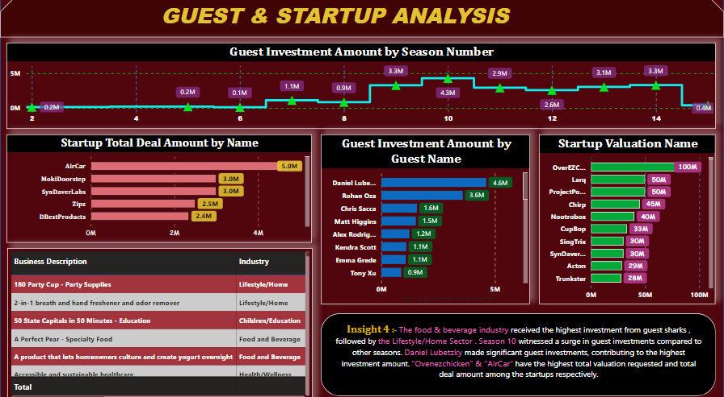
Maybe you need two columns
Mercury
Venus
Mercury is the closest planet to the Sun and the smallest one in the Solar System—it’s only a bit larger than the Moon
Venus has a beautiful name and is the second planet from the Sun. It’s hot and has a poisonous atmosphere

Slide 19
Mark Cuban leads with almost $60M in total investments, and made maximum deals signifying his prominent role in Shark Tank. Lori Greiner boasts the highest investment equity at $3.28K showcasing her impactful deals . Sharks favor Fashion/Beauty , Food & Beverages & Lifestyle/Home sectors indicating promising prospects for entrepreneurs in these areas.
Insight - 1
The food & beverage industry leads in terms of investment, successful deals, deal equity, & deal amount. The automotive industry stands out with the highest success rate, indicating a favorable environment 4 entrepreneurs in this sector. The lifestyle & home industry follow closely behind d automotive sector, offering potential for successful deals. Entrepreneurs targeting the food & beverage sector should aim for larger investments , but they should also refine pitches to improve their success rates. For those in the automotive, lifestyle & home industries, emphasizing their unique value propositions & profitability can lead to higher success rate.
Insight - 2
Seasons 5,6,7 witnessed the highest no. of pitches , indicating increased entrepreneurial activity during these seasons. Male entrepreneurs dominate the Shark Tank Pitches , with a higher success rate compared to other genders . Mark Cuban emerges as the top investor, with the highest total investments in pitches primarily led by male entrepreneurs.
Insight - 3
The food & beverage industry received the highest investment from guest sharks , followed by the Lifestyle/Home Sector . Season 10 witnessed a surge in guest investments compared to other seasons. Daniel Lubetzky made significant guest investments, contributing to the highest investment amount. "Ovenezchicken" & "AirCar" have the highest total valuation requested and total deal amount among the startups respectively.
Insight - 4

Slide 20

Data Source
Power Point for Dashboard Background Templates & Presentation
Power BI for Dashboard Development
SQL for Data Extraction & Transformation
MS Office for showing SQL snapshots
Tools & Technologies
Kaggle

Slide 21
Risk & Challenges
Data Availability and Quality
I need to invest time in data preprocessing and cleansing to make it usable for visualization.
Designing an effective dashboard requires understanding the audience's needs and creating visualizations that are intuitive and informative.
Large datasets or complex visualizations can impact the performance of the dashboard.
Since Data includes many null values , so handling with null values takes a lot of time.
Making a interactive ,informative and user friendly dashboards takes a lot of time.

Slide 22
Conclusion
“Shark Analytics” aims to transform Shark Tank data into a powerful resource for investors, entrepreneurs, and fans. By leveraging the capabilities of Power BI, we intend to provide a dynamic and insightful platform that unlocks the potential hidden within the wealth of data generated by the show. This project aligns with the growing interest in entrepreneurship and investment , making it a valuable asset for a wide audience.
Creating a dashboard with Shark Tank US data could provide valuable insights into various aspects of the show, such as the types of pitches that are most successful, the industries that attract the most investment, and the investors' preferences over time. The conclusion drawn from analyzing this data might include identifying trends, patterns, and factors that contribute to successful pitches, as well as understanding the dynamics of the investment landscape within the context of the show. Additionally, insights gained from the dashboard could potentially inform future contestants, investors, and researchers interested in entrepreneurship and venture capital.

Slide 23

Don’t Start a business. Find a problem. Solve a Problem . The business comes second ~ Robert Herjavec Don’t cry about money , it never cries for you. ~ Kevin O’Leary
THANK YOU !!!
Submitted By :-
Kirti Agarwal
PGA 37

